Slide 1
Version Control Systems
What They Are and How to Use Them
Elisheva Strauss
7/31/2018
Maalot Capstone Senior Thesis Presentation

Slide 2
Summary
What is Version Control- an example
Common Terminology
Some Common Commands Using Git
Wrap Up

Slide 3

The Maalot Coders
John makes changes
File A
File A
String student = “Unknown”;
String student = “Unknown”
student = “John”

Slide 4
The Maalot Coders (continued)
Code conflicts
John’s Changes
String student = “Unknown”;
student = “John”;
Charlie wants to make a change
File A
File A
String student = “Unknown”;
String student = “Unknown”;

Slide 5
The Maalot Coders (continued)
Causes a bug
File A
String student = “Unknown”;
student = “John” xyz

Slide 6
The Maalot Coders (continued)
Not Needed Anymore

Slide 7
Version Control Systems Solve These Problems and More
Keep track of all changes
Who made them
When
What each change does
Reveal conflicts in the code
Allow the developers to go back in history
Supports merging of developer’s code to the main branch (trunk/master)

Slide 8
Common Terminology
Repository
A group of files that is under version control
Trunk
The main version of the code (called master in git)
Branch
Divide from the trunk to attempt something new. Does not affect the trunk/master
Working Directory
Code that is being changed currently. Changes based on the branch.

Slide 9
Common Terminology (continued)
Commit
Save changes to a branch
Merge
Combine branches
Log
See history
Revert
Undo a specified commit
Reset
Go back to what the branch looked like at the specified commit

Slide 10
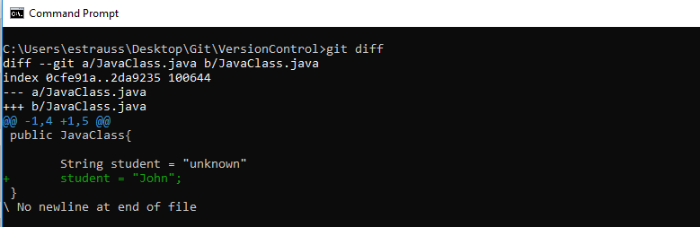
Some Common Commands Using Git

Slide 11
Some Common Commands Using Git
git diff

Slide 12

Some Common Commands Using Git
git add

Slide 13
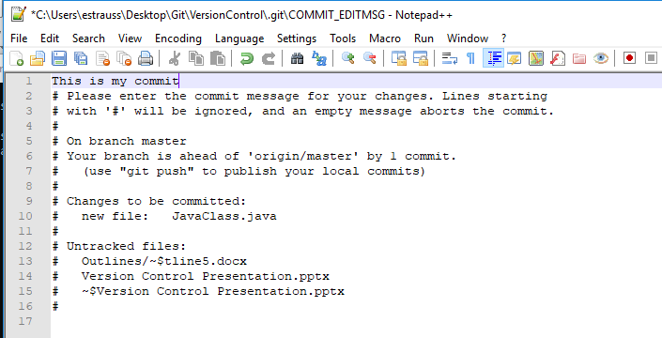
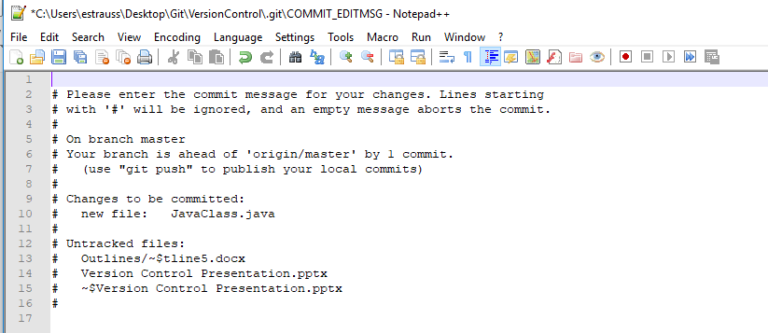
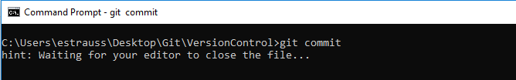
Some Common Commands Using Git
git commit

Slide 14
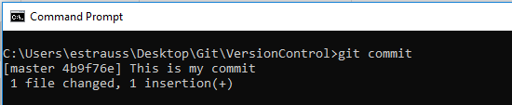
Some Common Commands Using Git
git commit

Slide 15
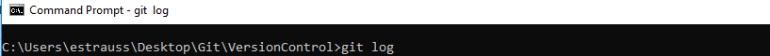
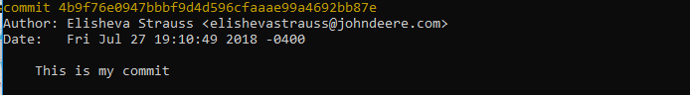
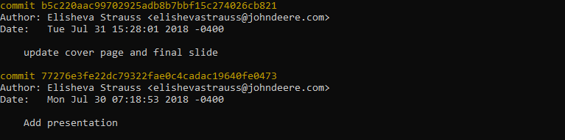
Some Common Commands Using Git
git log

Slide 16
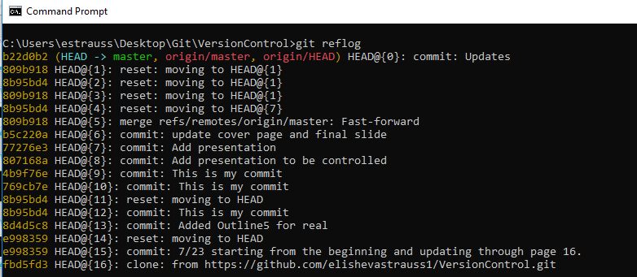
Some Common Commands Using Git
git reflog

Slide 17
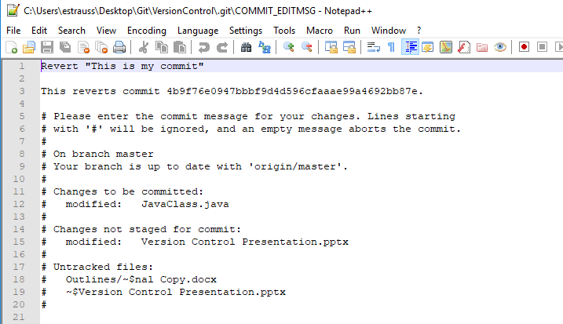
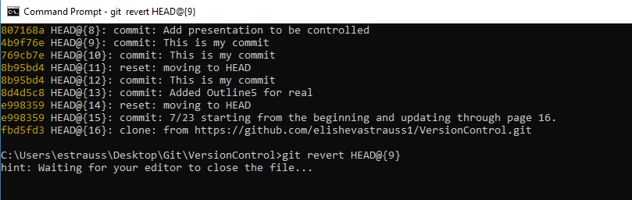
Some Common Commands Using Git
git revert

Slide 18
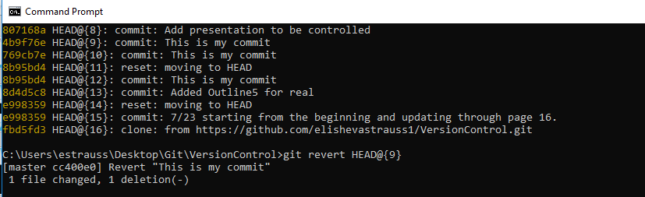
Some Common Commands Using Git
git revert

Slide 19
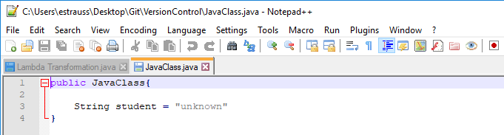
Some Common Commands Using Git
git revert

Slide 20
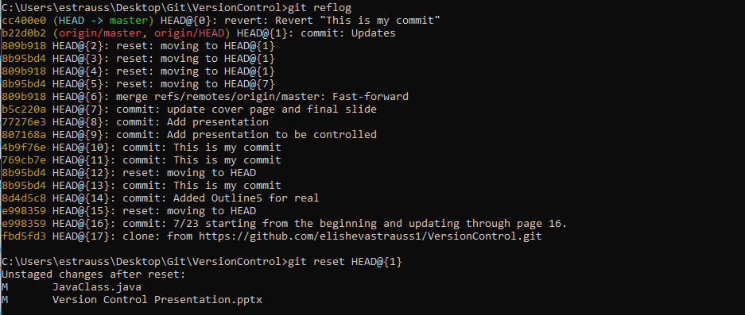
Some Common Commands Using Git
git reset

Slide 21
Version Control Systems Allow
Easy maintenance of code
Undoing
Branching
Merging
Multiple developers to work on the same code
Version Control Systems lead to organized, bug free code

Slide 22
Thank you for listening! Any Questions?

